Slide 1
Introductory To Programming and Problem-Solving Skills
Data structures in Python
Tutorial Week - 5

Slide 2
Activity!
We need 5 volunteer’s for this activity.
Let’s align them in a straight line and perform the methods of list accordingly!!
For eg: append, insert, delete.
We can also extend, the activity with for loop iterating each student and if statement!!

Slide 3
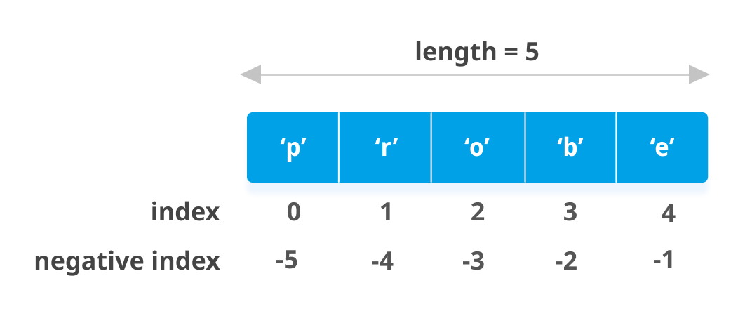
What is List?
A List is a linear data structure in python that is mutable, or changeable ordered sequence of elements.
List contains of mixed elements and each element that is inside value is called an item.
It is defined by having values between square brackets [].
Note: List indices starts from 0

Slide 4
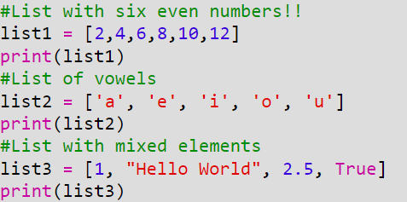
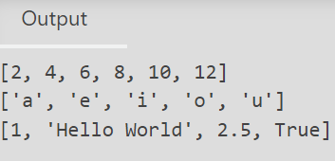
List Examples

Slide 5
Common List Operations
Access List
Insert List
Edit/Update List
Delete List
List Concatenation
List Repetition
List Membership
List Slicing
Note: Lists are mutable!!

Slide 6
Let’s Create a list of car collection!!

Slide 7
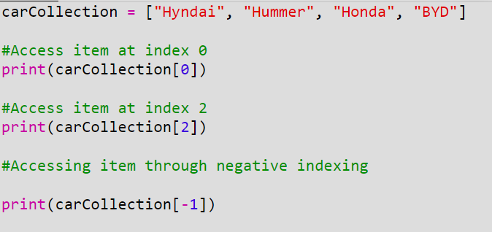
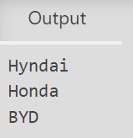
Let’s Access From Your Car From List!!
access()
WE CAN ACCESS FROM BOTH POSITIVE AND NEGATIVE INDEXING. But list cannot go out of bound!!

Slide 8
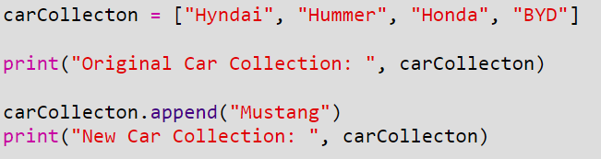
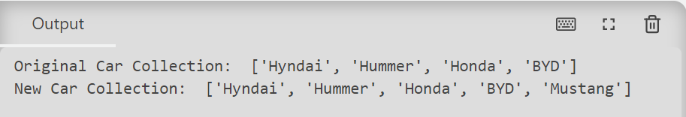
Let’s add a new car!!
append()

Slide 9
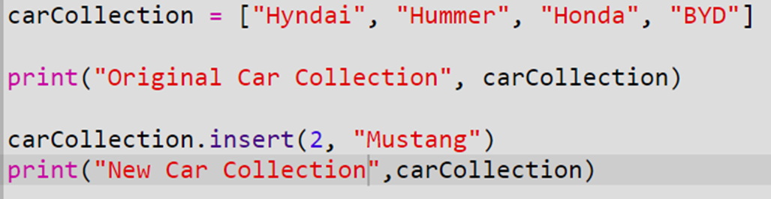
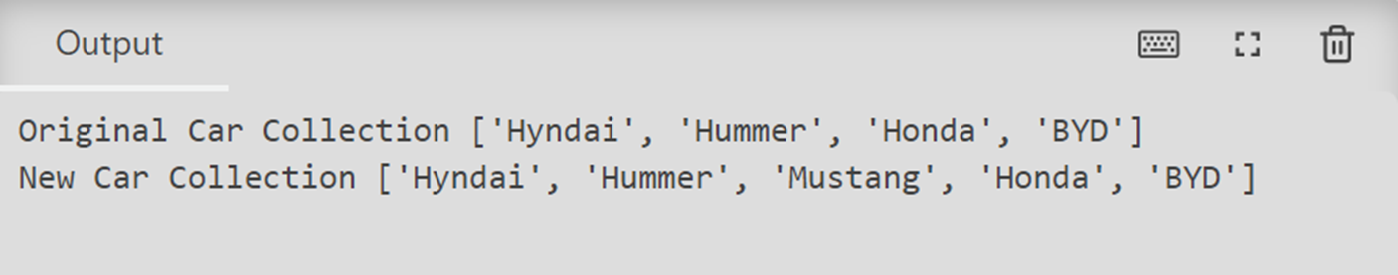
Let’s get you a new car and put right after Hummer!!
insert()

Slide 10
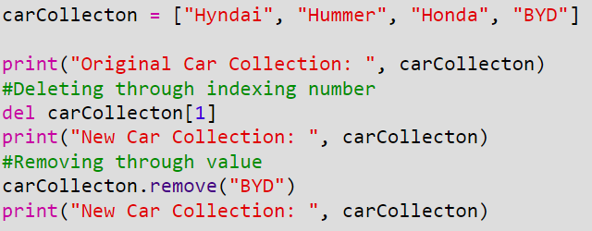
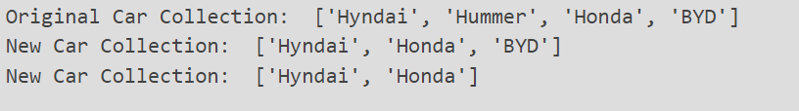
Let’s sell your cars Hummer and BYD!!
del []
remove ()

Slide 11
There are other methods in list which you might want to use!!
len()
clear
extend()
count()
index()
pop()
reverse()
sort()
sorted()
min()
max()
sum()
You might want to explore this for 10 min, and discuss with example in class!! FOR THE LINK GO THROUGH LECTURE CONTENT.

Slide 12

REMEMBER!!!
There are other additional list operation!!
List Concatenation: Python allows us to join two or more lists using concatenation operator depicted by the symbol “+”
List Repetition: Python allows us to replicate a list using repetition operator depicted by “*”
List Membership: Like strings, membership operator "in" checks if the element is present in the list and return TRUE, else FALSE.
List Slicing: Like string, slicing operator can be used in list as well.

Slide 13
List Iteration
We can access every element of the list one by one which is called list traversal.
We can access element of the list or traverse a list using a for loop or while loop.

Slide 14
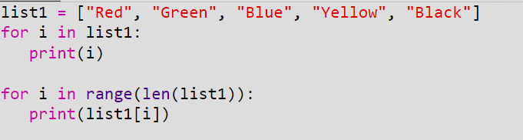
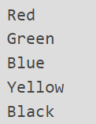
List Iteration with for loop
Output
We can access through list using for loop in two ways:
Iterating over value of list
Iterating over indexing of list. During this process we need identify the length of the list.

Slide 15
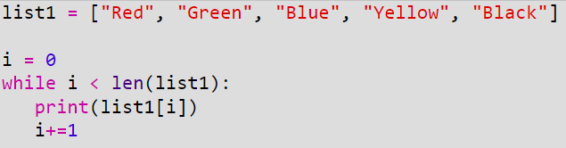
List Iteration with while loop
Output
Likewise, using while loop we need to compare it with the length of the loop.

Slide 16


Nested List
What is Nested List?
When a list appears as an element of another list, it is called a nested list.
Output
We can iterate over nested lists as well either from for loop or while loop.

Slide 17



List Comprehension
List comprehension is a concise way to create a new list by iterating over an existing list, sequence, or any iterable object, and applying a condition or transformation to each element .
Syntax
new_list = [expression for item in iterable if condition]

Slide 18
For You
Write a menu driven program to perform various list operation, such as:
Append an element
Insert an element
Append a new list to the given list
Modify an existing element from its position
Delete an existing element from its position
Delete an existing element with a given value
Sort the list in ascending order
Display the list

Slide 19
What is Tuple?
A tuple is a linear data structure in python that is similar to list. However, in tuple is immutable means, we can only access in tuple but we cannot alter in tuple like list.
However, We can convert tuple to list to perform various operations like adding, updating and removing items.

Slide 20
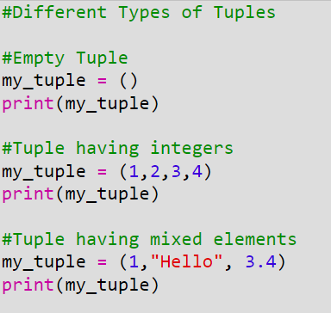
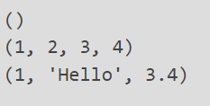
Tuple Examples
Output

Slide 21
What Dictionary?
Dictionary is a defined as an ordered set of key:value pairs, with requirement that the keys are unique.
Dictionary are Mutable data type.
To create a dictionary, the items are entered are separated by commas and enclosed in curly braces.
Key must be unique and should be any immutable data type, i.e., number, string or tuple.

Slide 22
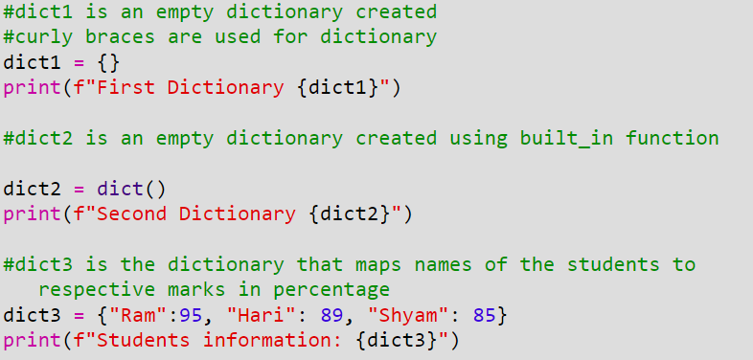
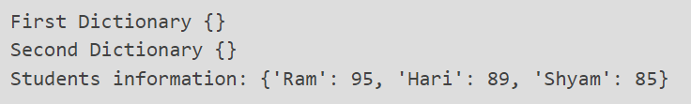
Dictionary Examples

Slide 23
Common Dictionary Operations
Accessing items in a Dictionary
Adding a new items in a Dictionary
Modifying an Existing Item
Membership in Dictionary
Traversing in Dictionary
Note: Dictionary are mutable!!

Slide 24
Let’s Create a dictionary of car owner and their cars

Slide 25
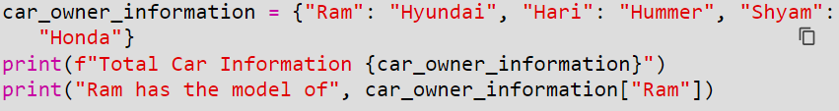
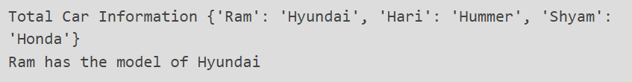
Let’s Access From Your Car

Slide 26
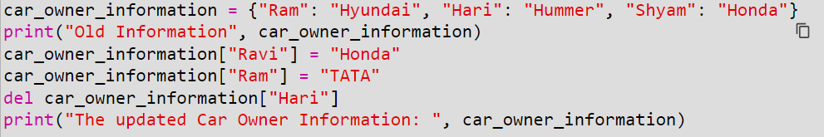
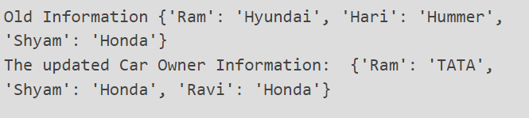
Let’s add and modify a new car owner!!

Slide 27
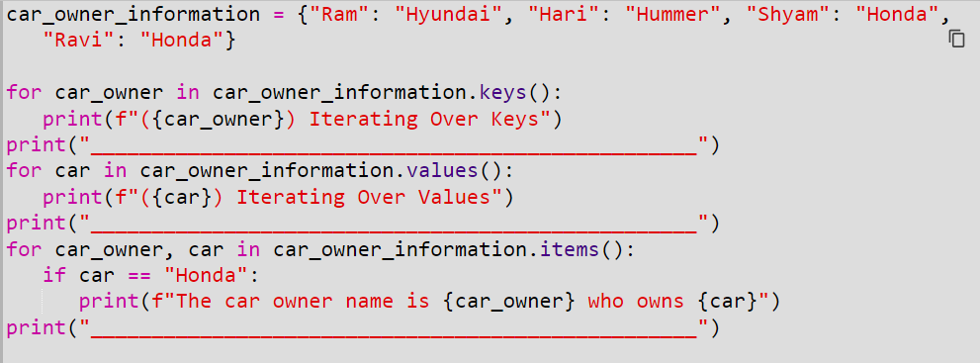
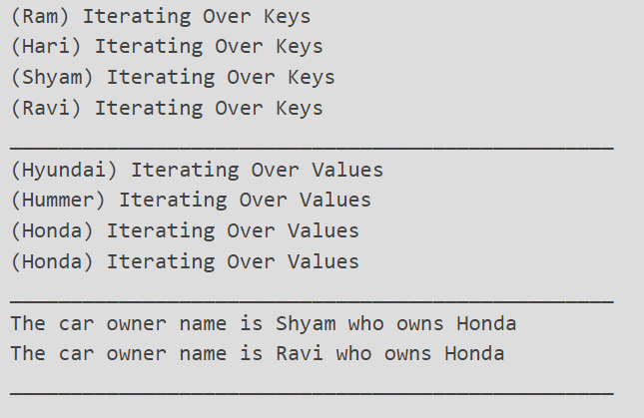
Iteration over dictionary

Slide 28
There are other methods in dictionary which you might want to use!!
len()
dict()
keys()
values()
items()
get()
update()
del()
clear()
You might want to explore this for 10 min, and discuss with example in class!! FOR THE LINK GO THROUGH LECTURE CONTENT.

Slide 29
The Set Data Type
A set is an unordered collection with no duplicate elements.
Set objects also, support mathematical operations like union, intersection, difference and symmetric difference.
Curly braces or the set() function can be used to create empty sets.

Slide 30
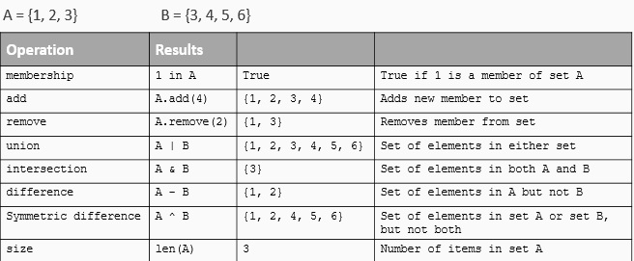
Set Operation in Python
There are two types of set in python which are mutable and immutable so generally for immutable sets, we declare it with frozenset() type.

Slide 31
For You – Exercise
Write Python to program to get the 4th index and the last index of a tuple
Write a program to find the number of times an element occurs in the list.
Write a python program to find the largest number from a list.
Write a program to read a list of n integer (positive as well as negative). Create a new lists, one having all positive number and the other having all negative numbers from the given list. Print all three lists.

Slide 32
For You – Exercise
Create a nested list of your favorite movies, with each sub-list containing the name of the movie and year of release. Print the first movie and the year of release for the second movie in the list.
Write a program to read a list of elements. Input an element from the user that has to be inserted in the list. Also input position, at which it is to be inserted.
Write a program to read a list of n integers and find their median.
Note: The median value of a list of values is the middle one when they are arranged in order. If there are two middle values then take their average.
Hint: You can use built-in-function to sort the list.

Slide 33
For You – Additional Questions
Imagine that you are working on a project to assist a nearby library in managing their book inventory. they want you to design a program that enables them to add new book, remove old books, and perform advanced book searches. You make the decision to use a list to store all of the library's books.
Tasks: Create a python program that prompts user with dashboard menu as follows:
1) Add a new book
2) Remove a book
3) Search for book
4) List all the books
5) Quit.

